Slide 1
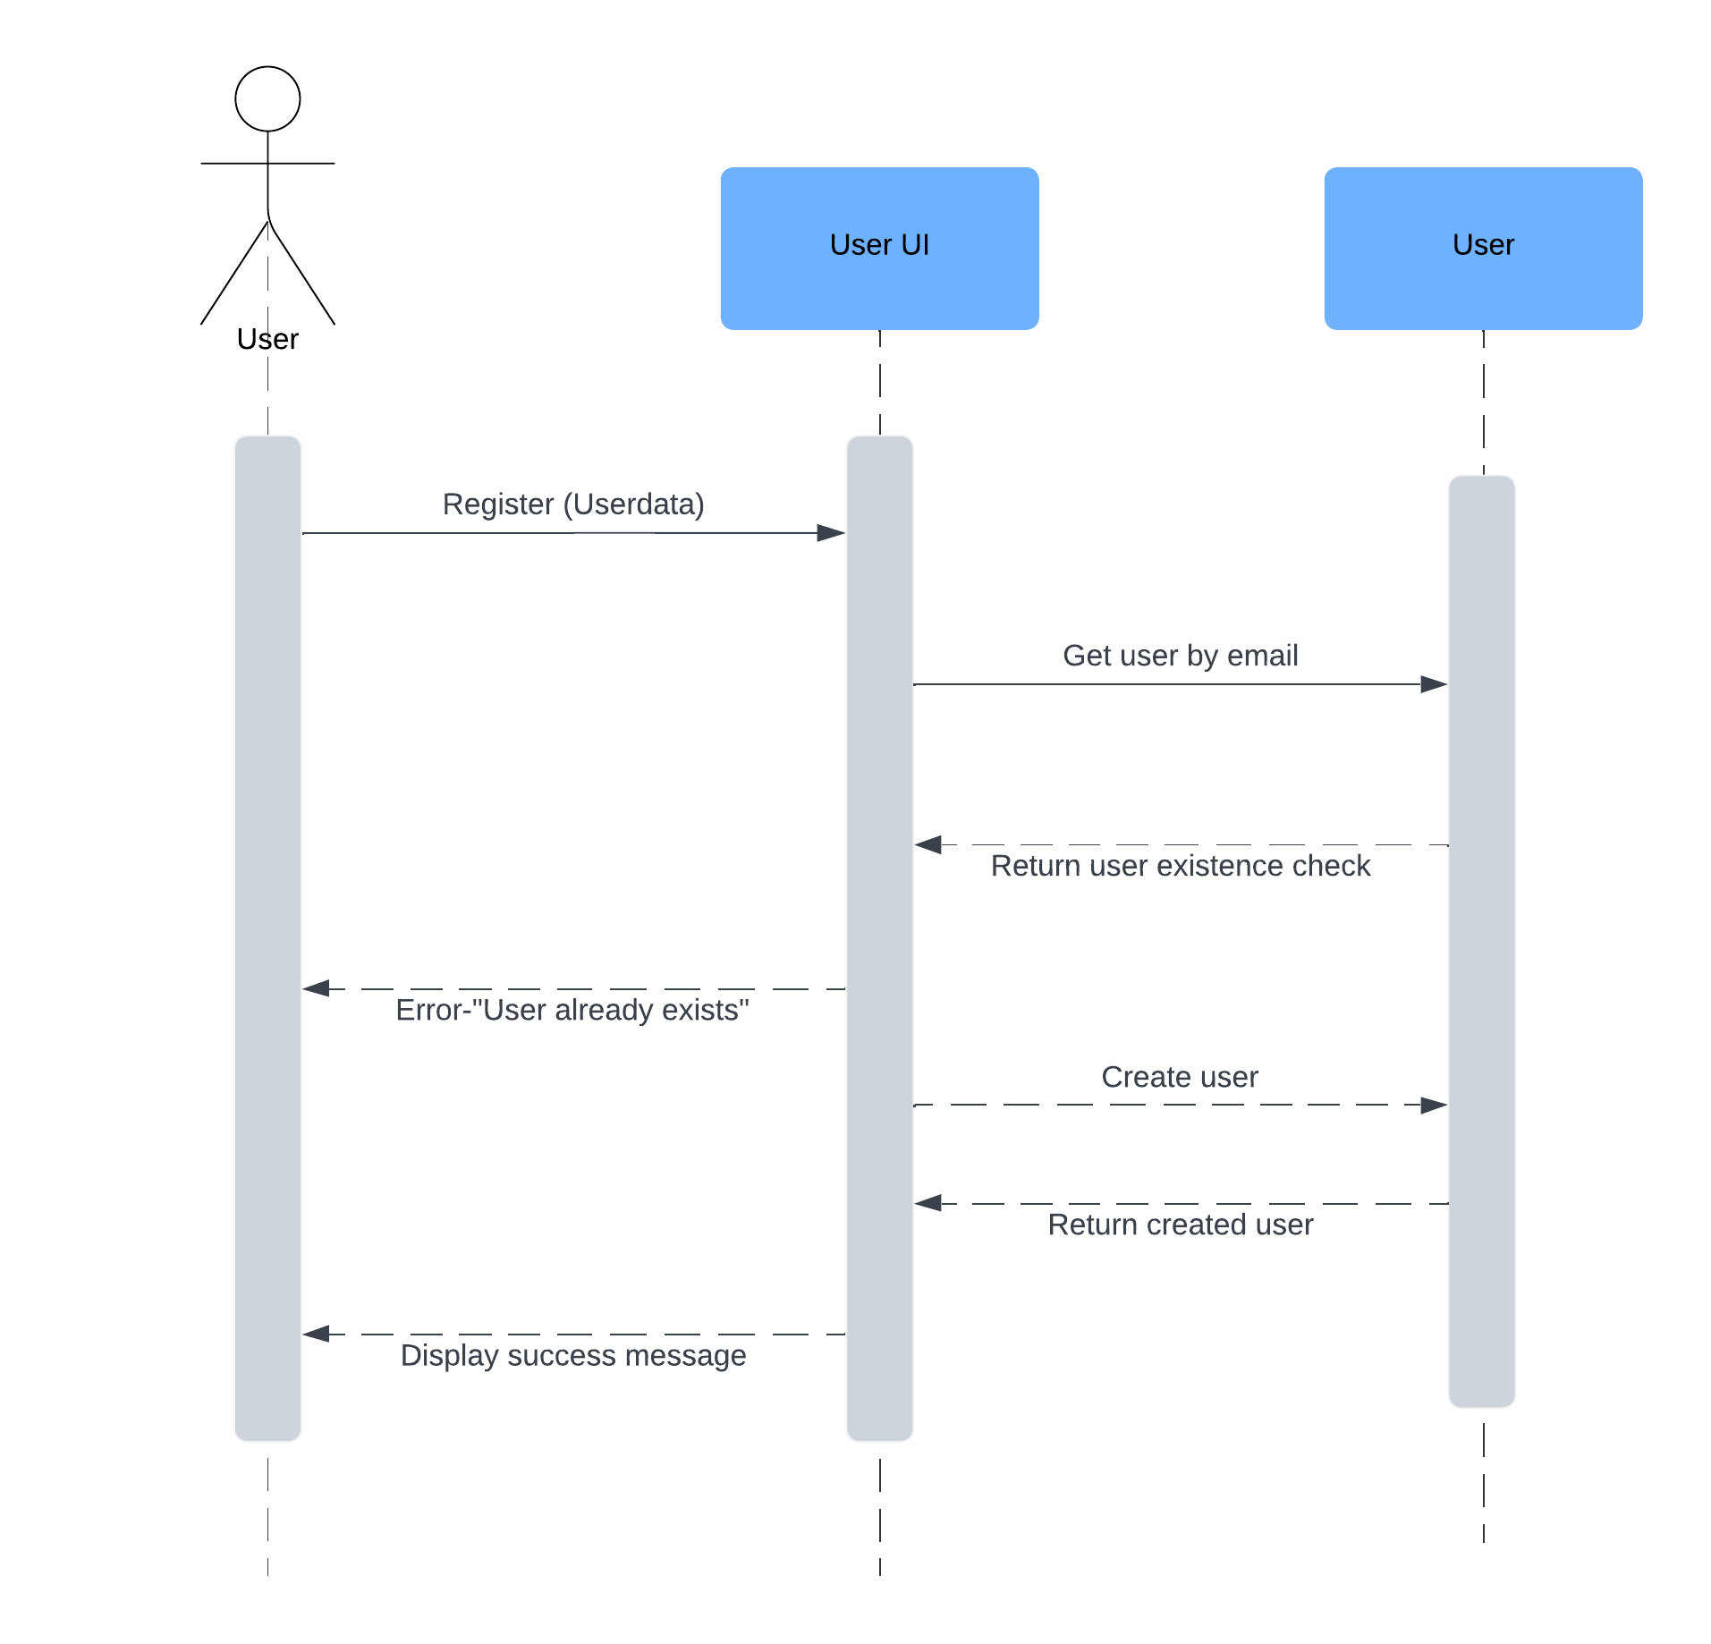
STYLEHIVE – SEQUENCE DIAGRAM S2
User Story - 01.01 : Create User Account
User Story Outline
The user initiates registration by submitting their details.
The Client forwards the registration data to the Server.
The Server checks if the user already exists by querying with the email.
If the user exists, the Server sends an error back to the Client indicating "User already exists."
If the user does not exist, the Server creates a new user in the database.
The Client displays a success message to the user confirming registration.

Slide 2
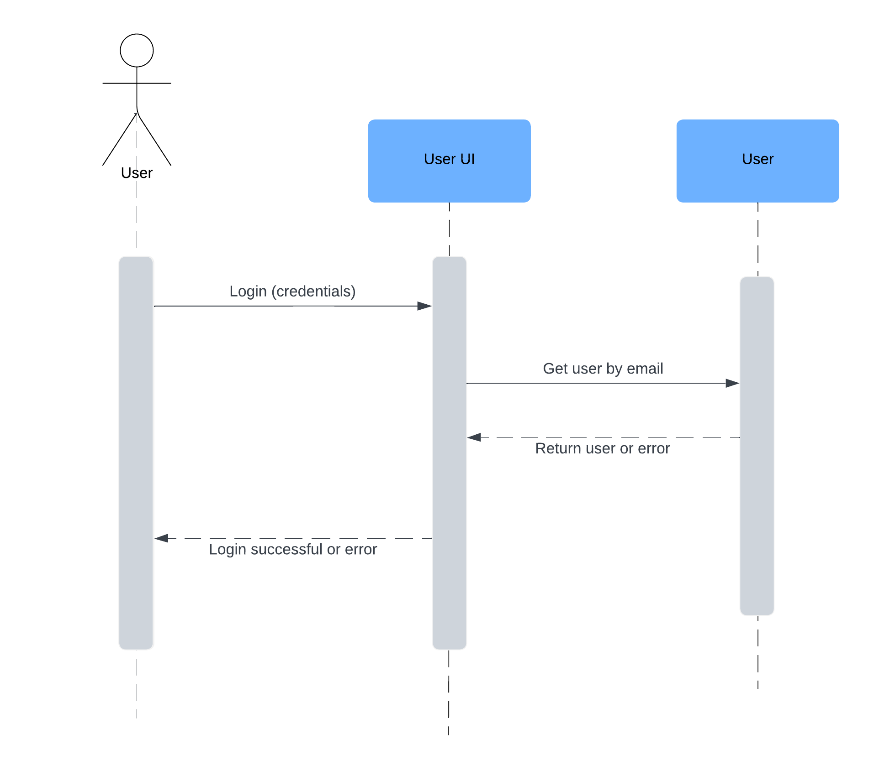
User Story - 01.02 : Log into Account
User Story Outline
The user initiates login by entering their credentials.
The Client sends the credentials to the Server.
The Server retrieves the user using the provided email.
If the credentials match, the Server returns a success message; otherwise, an error message.
The Client displays a login success or error message based on the Server's response.
The use case ends once the user is logged in or notified of an error.

Slide 3
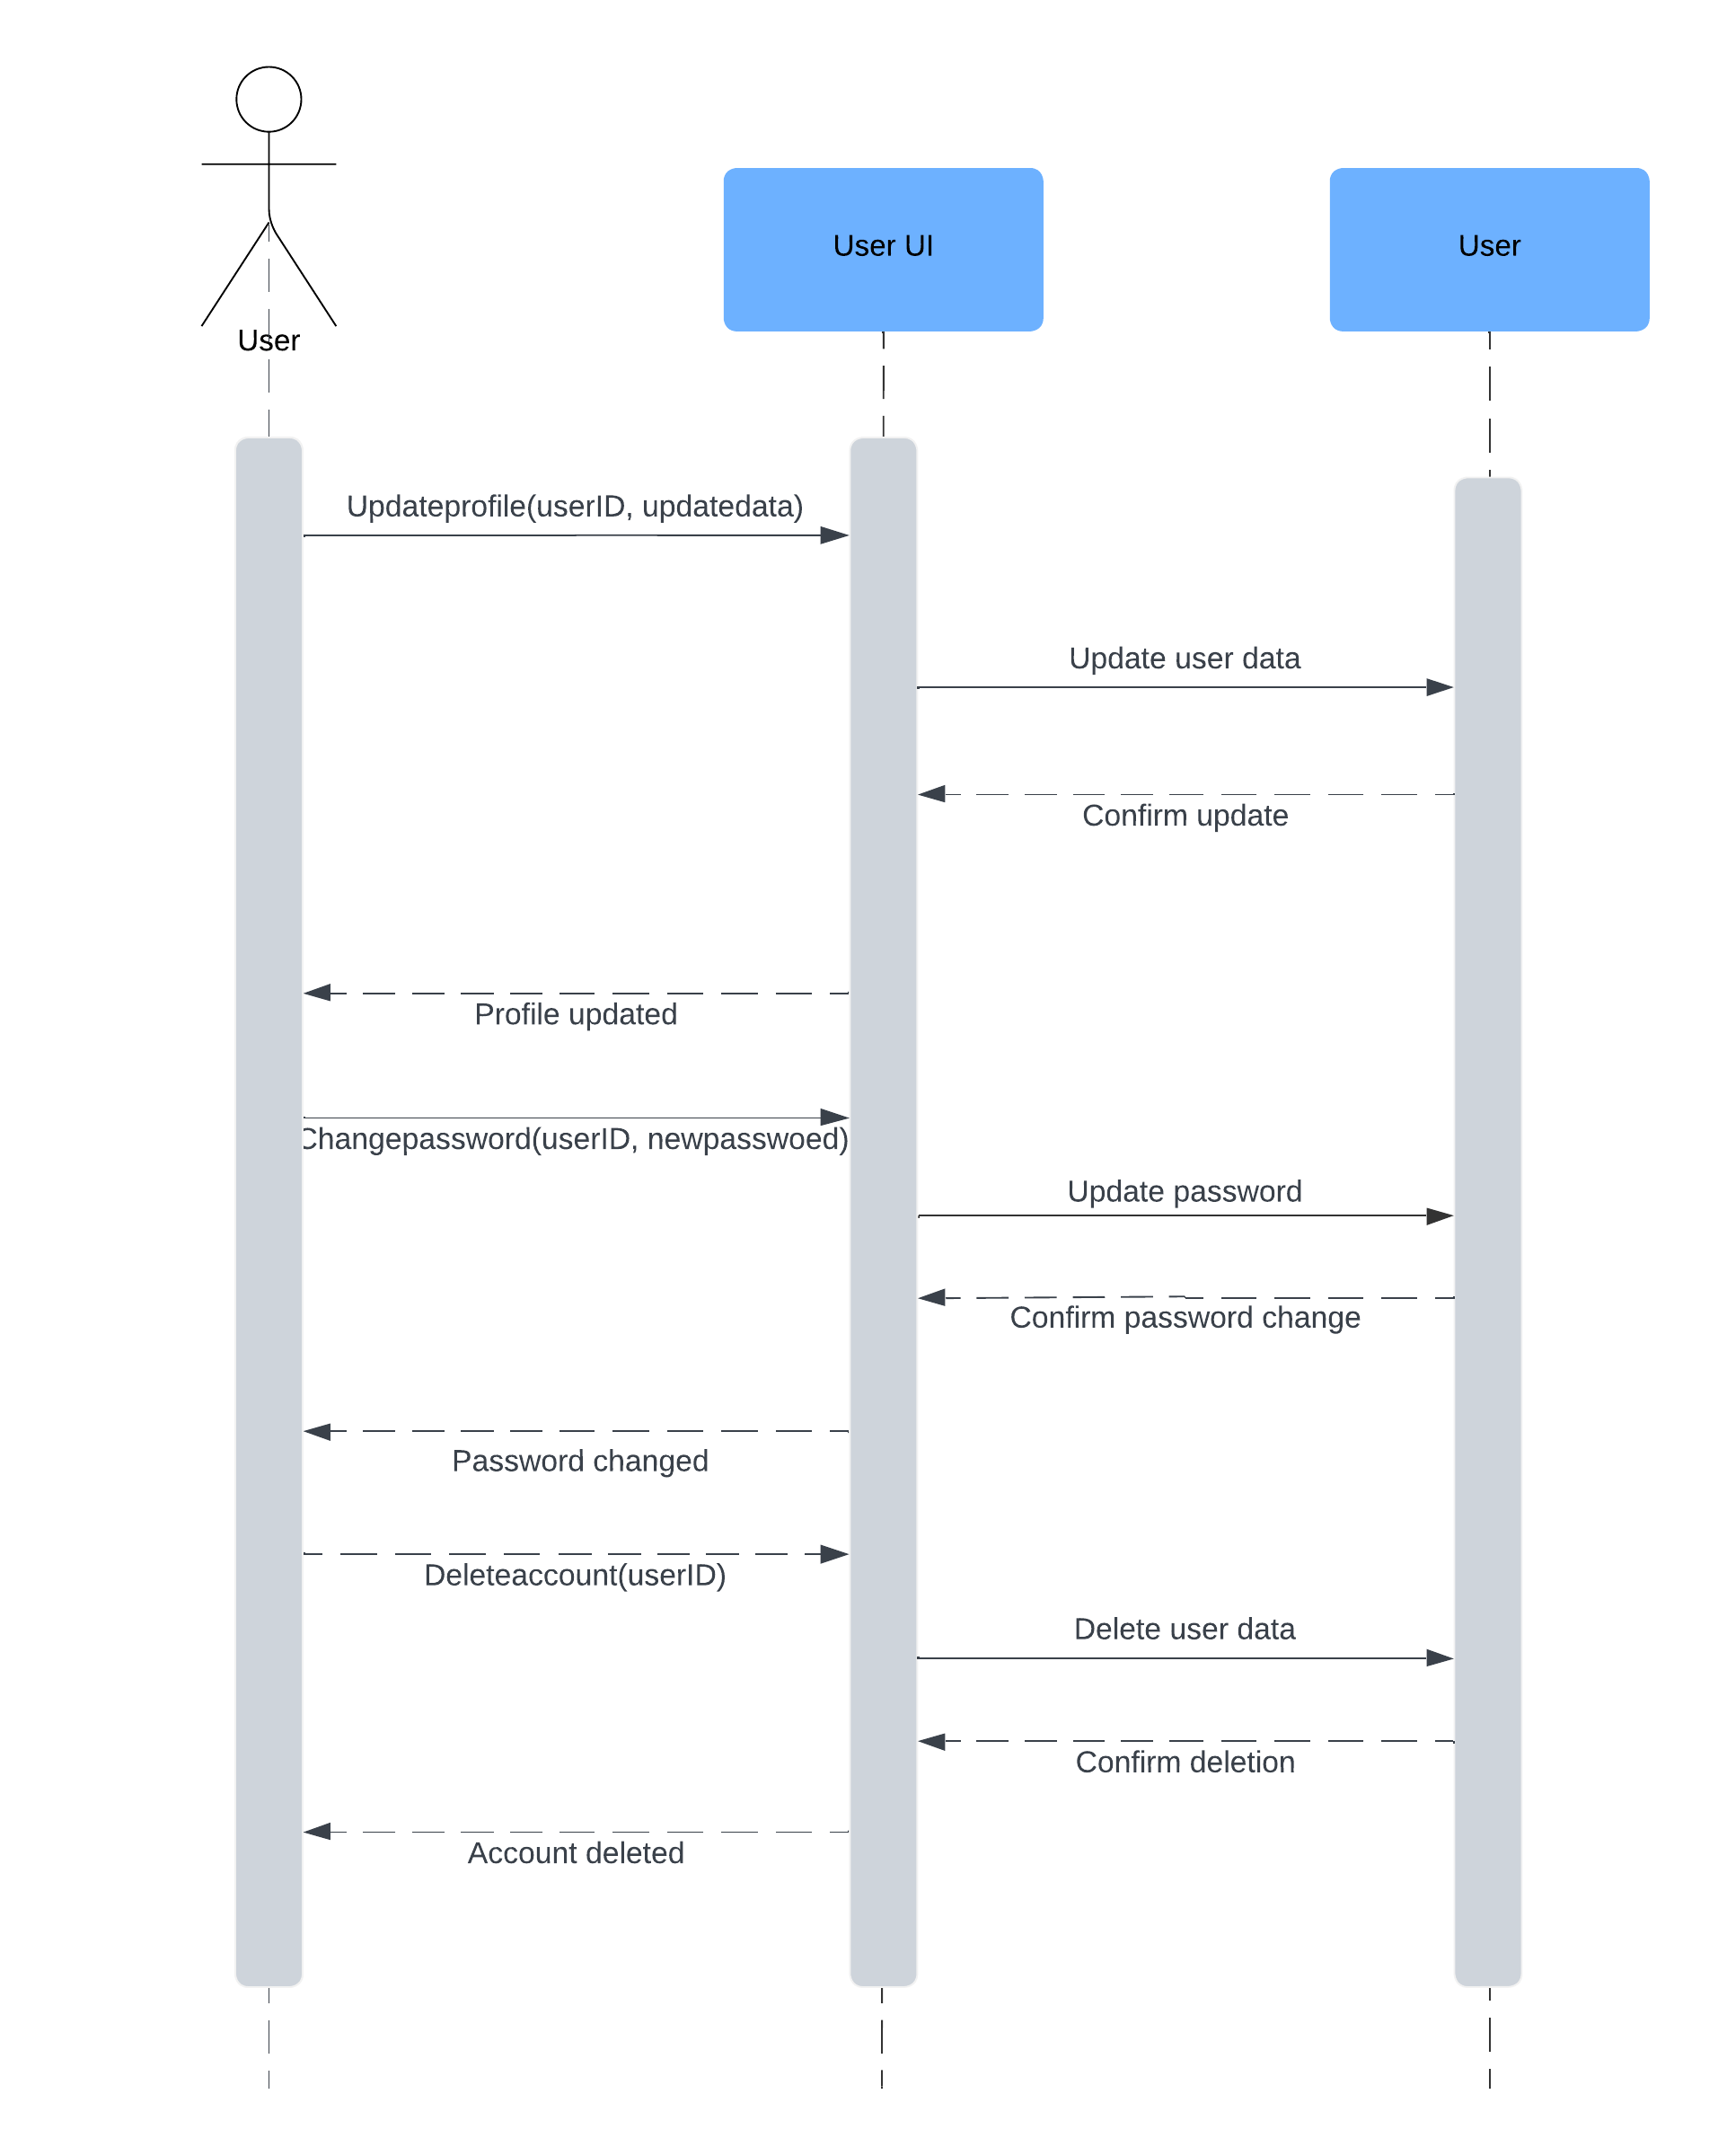
User Story - 01.03 : Manage User Profile
User Story Online
1. The user initiates profile management by editing their profile details.
2. ProfileUI sends the updated profile data to ProfileService for processing.
3. ProfileService validates the new data and ensures it meets the required standards.
4. ProfileService updates the user’s profile in the Database.
5. Database confirms the successful update to ProfileService.
6. ProfileUI displays a confirmation message to the user, ending the profile update process.

Slide 4
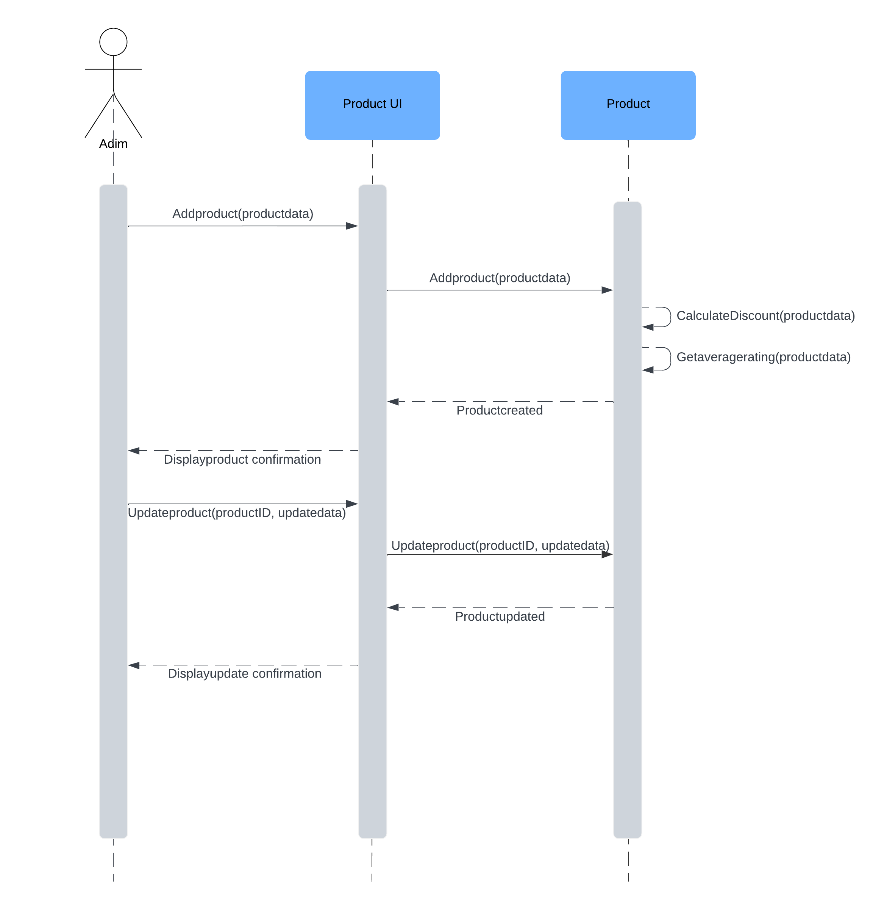
User Story - 02.01 Create Product
User Story Outline
The admin initiates product creation or updates with the relevant data.
ProductUI sends the data to ProductService for processing.
ProductService applies discount calculations and retrieves ratings (if applicable).
For updates, ProductService modifies the product and returns a success message.
ProductUI displays a creation or update confirmation to the admin.
The use case ends with a confirmation or error message displayed to the admin.

Slide 5
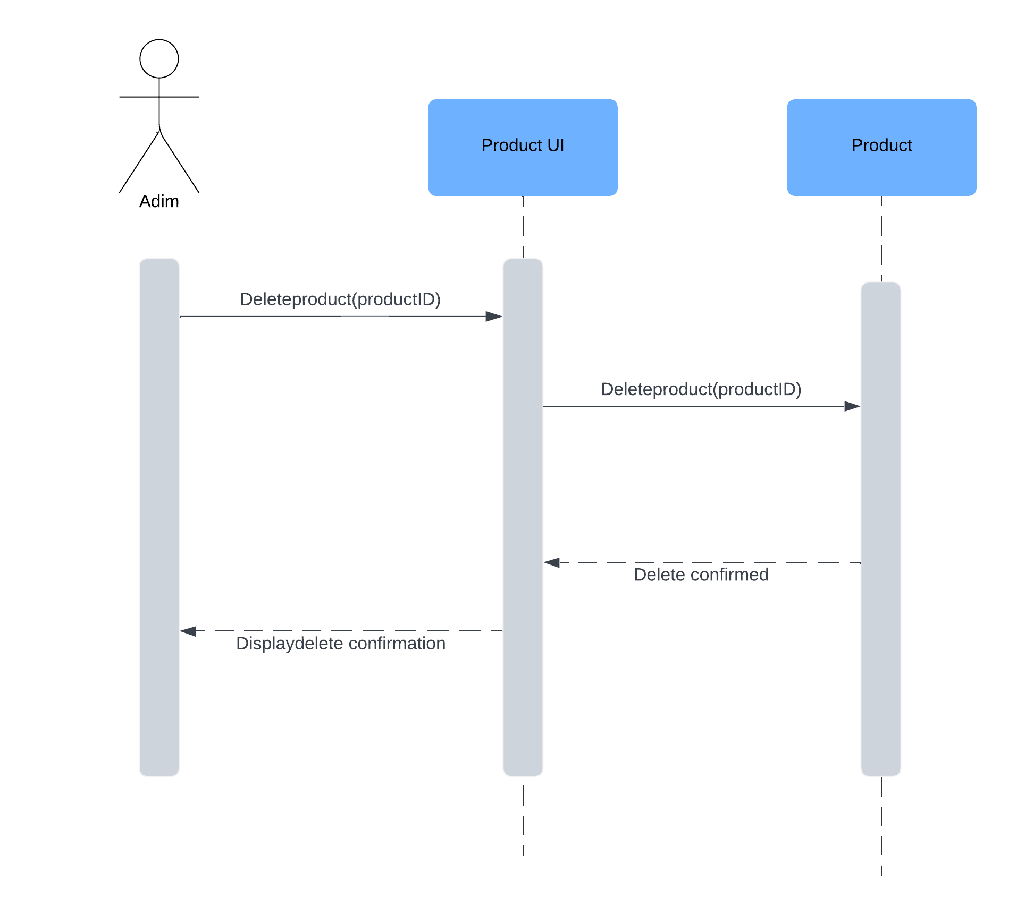
User Story – 02.02 Delete Product
User Story Outline
1. The user selects the "Delete Product" option for the desired product.
2. The system prompts the user to confirm the deletion action.
3. The user confirms the deletion.
4. The system sends a delete request to `ProductService`.
5. `ProductService` removes the product from the database.
6. The system displays a confirmation message, indicating the product was successfully deleted.

Slide 6
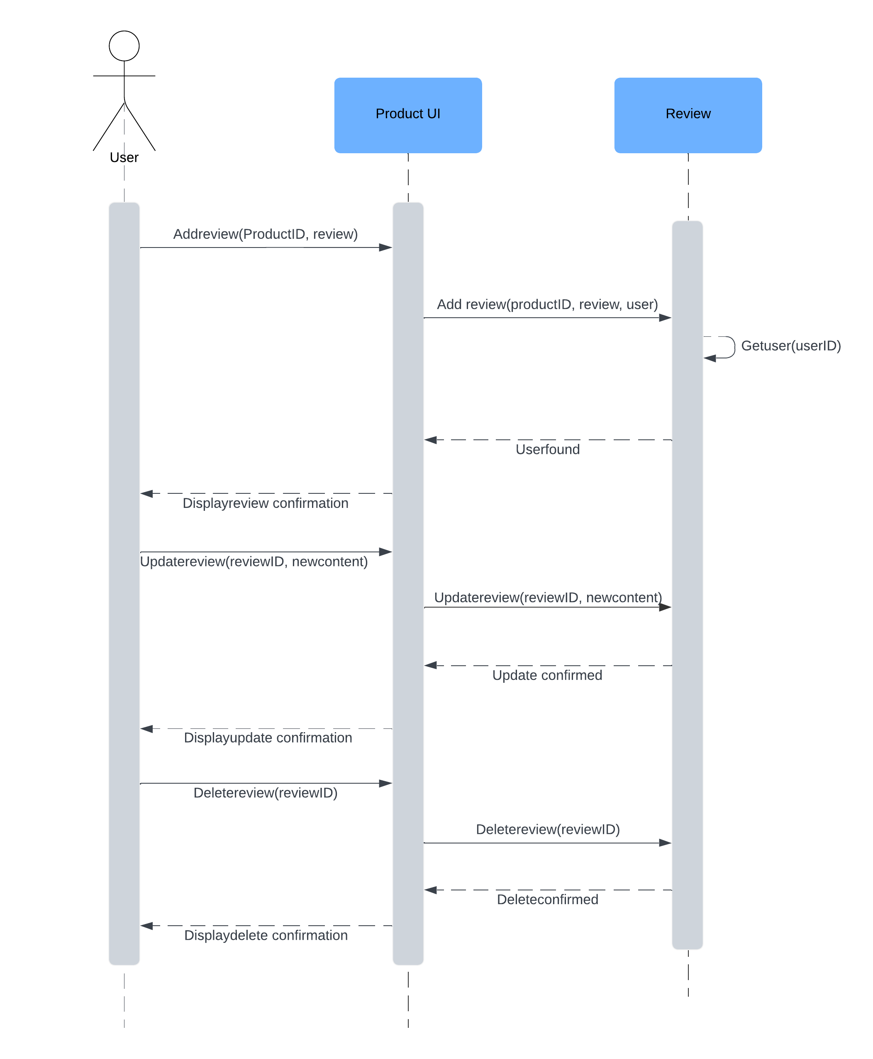
User Story – 02.03 Product Reviews
User Story Outline
1. The user adds, updates, or deletes a review by entering, editing, or requesting removal of review content for a product.
2. ProductUI forwards the review action (add, update, or delete) along with review details and product ID to `ProductService`.
3. ProductService verifies the user's identity to ensure action authorization.
4. For adding or updating, `ProductService` stores or updates the review in the database; for deleting, it removes the review.
5. ProductUI displays confirmation to the user, indicating the review was successfully added, updated, or deleted.
6. The use case ends after the user receives confirmation.

Slide 7
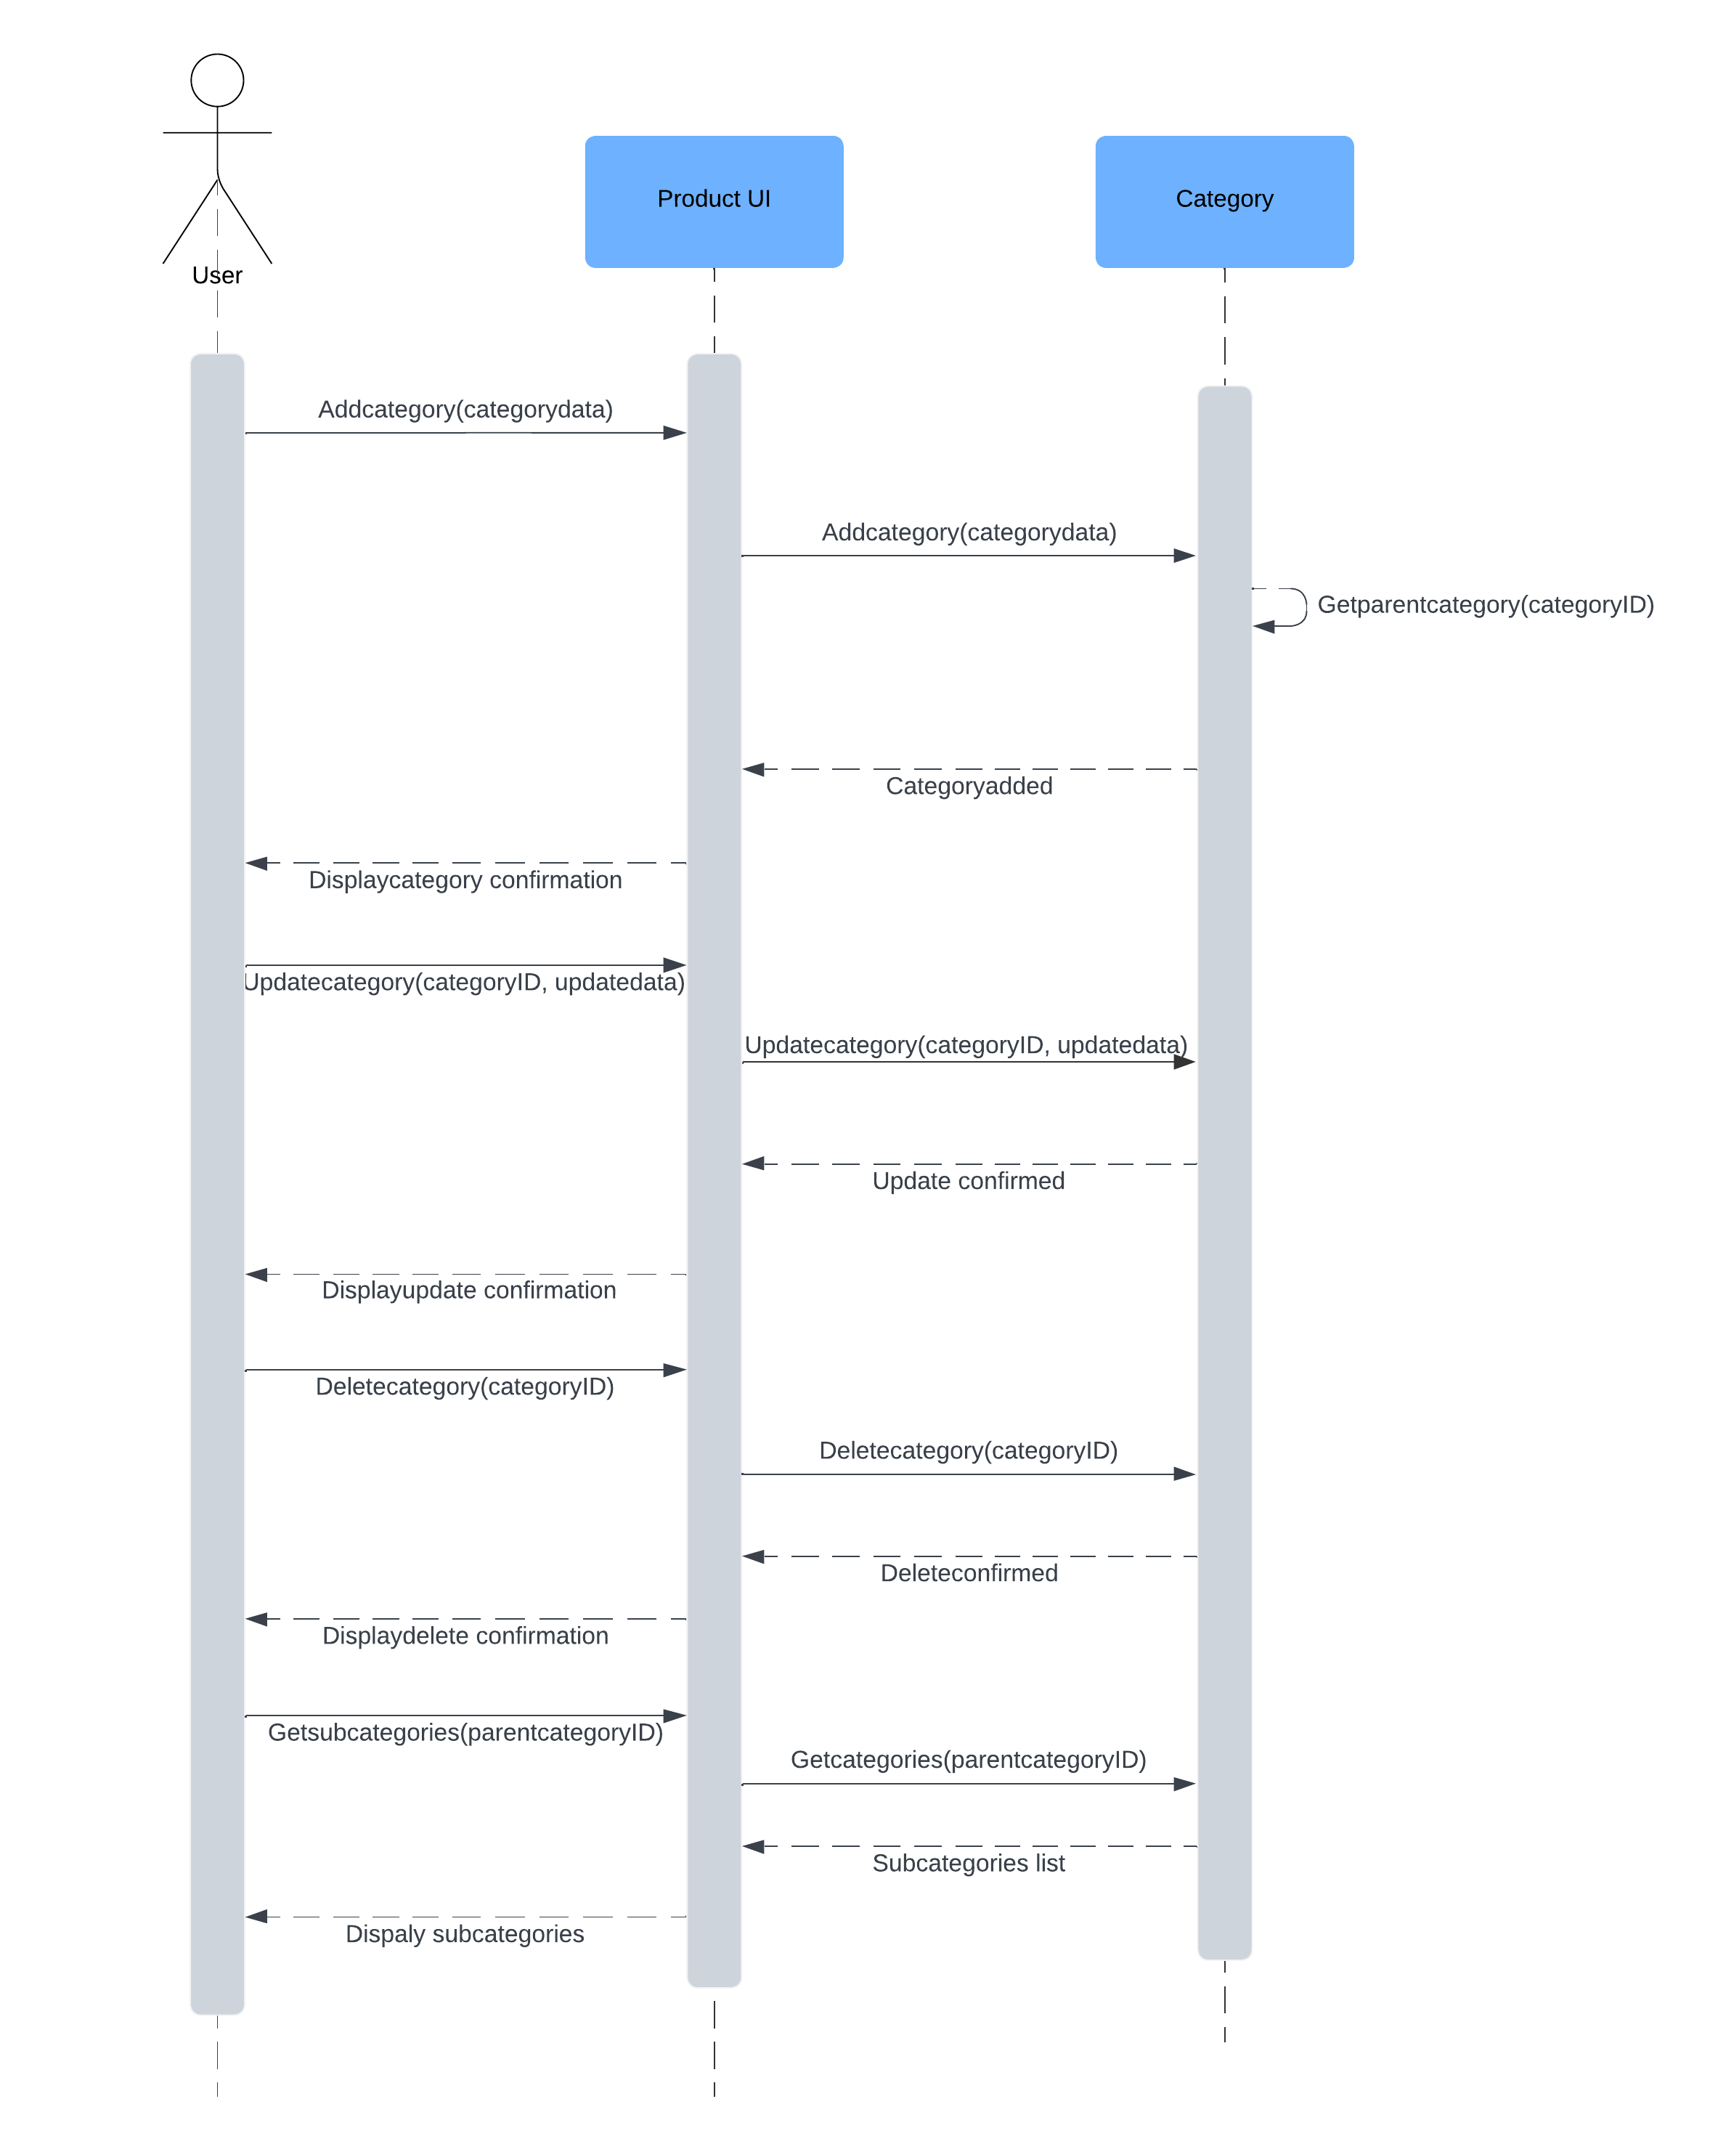
User Story – 02.04 Product Categories
User Story Outline
Product Category Management
The user initiates actions to add, update, delete, or retrieve subcategories.
For adding a category, the ProductCategoryUI sends category data to ProductCategoryService.
ProductCategoryService verifies parent category (if needed) and adds the new category.
For updates, the ProductCategoryUI sends the modified data to ProductCategoryService.
ProductCategoryService processes updates, deletions, or subcategory retrieval and confirms success.
ProductCategoryUI displays confirmation or an error message to the user.
2. Create and Update Product
The admin initiates product creation or updates with the relevant data.
ProductUI sends the data to ProductService for processing.
ProductService applies discount calculations and retrieves ratings (if applicable).
For updates, ProductService modifies the product and returns a success message.
ProductUI displays a creation or update confirmation to the admin.
The use case ends with a confirmation or error message displayed to the admin.
3. Delete Product
The admin selects a product to delete.
ProductUI sends the delete request to ProductService.
ProductService deletes the specified product.
ProductService returns a confirmation message.
ProductUI displays the delete confirmation to the admin.
The use case ends with a success or error message shown to the admin.

Slide 8
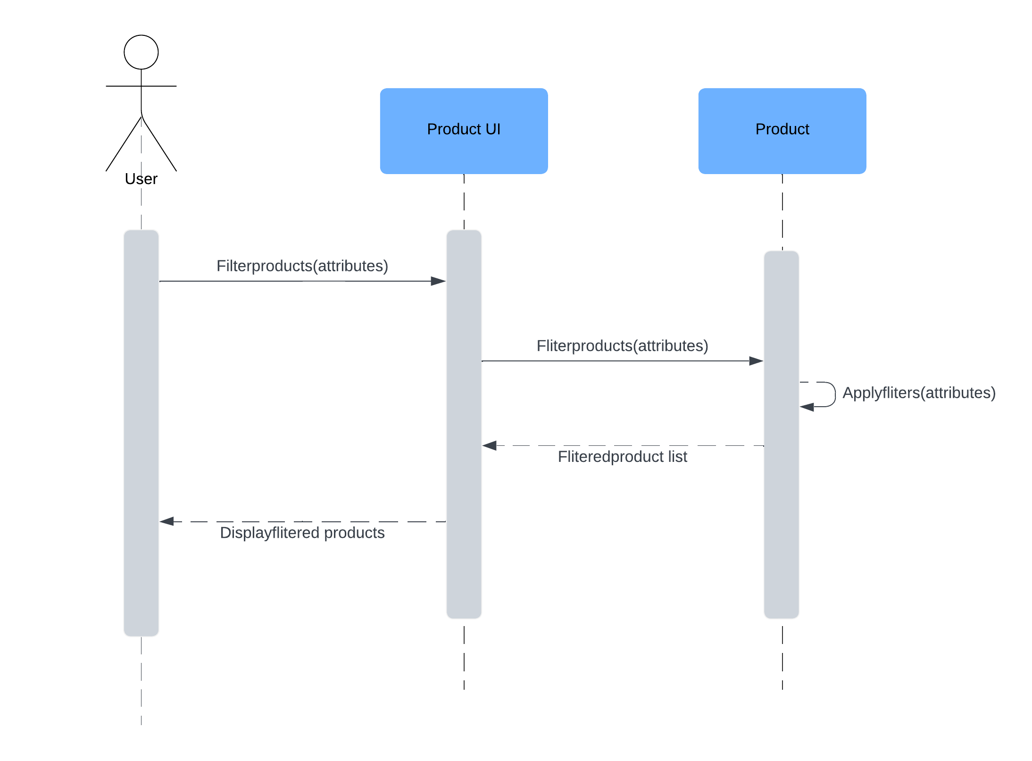
User Story – 02.05 Filters Products by attributes
User Story Outline:
1. This use case begins when the user applies a filter with specific attributes to the product listings.
2. The system (ProductFilterUI) receives the filter request and forwards it to the ProductService.
3. ProductService applies the filter based on the provided attributes.
4. ProductService returns the list of products that match the filter criteria to the ProductFilterUI.
5. ProductFilterUI displays the filtered product list to the user.
6. The use case ends when the user views the filtered product listings.

Slide 9
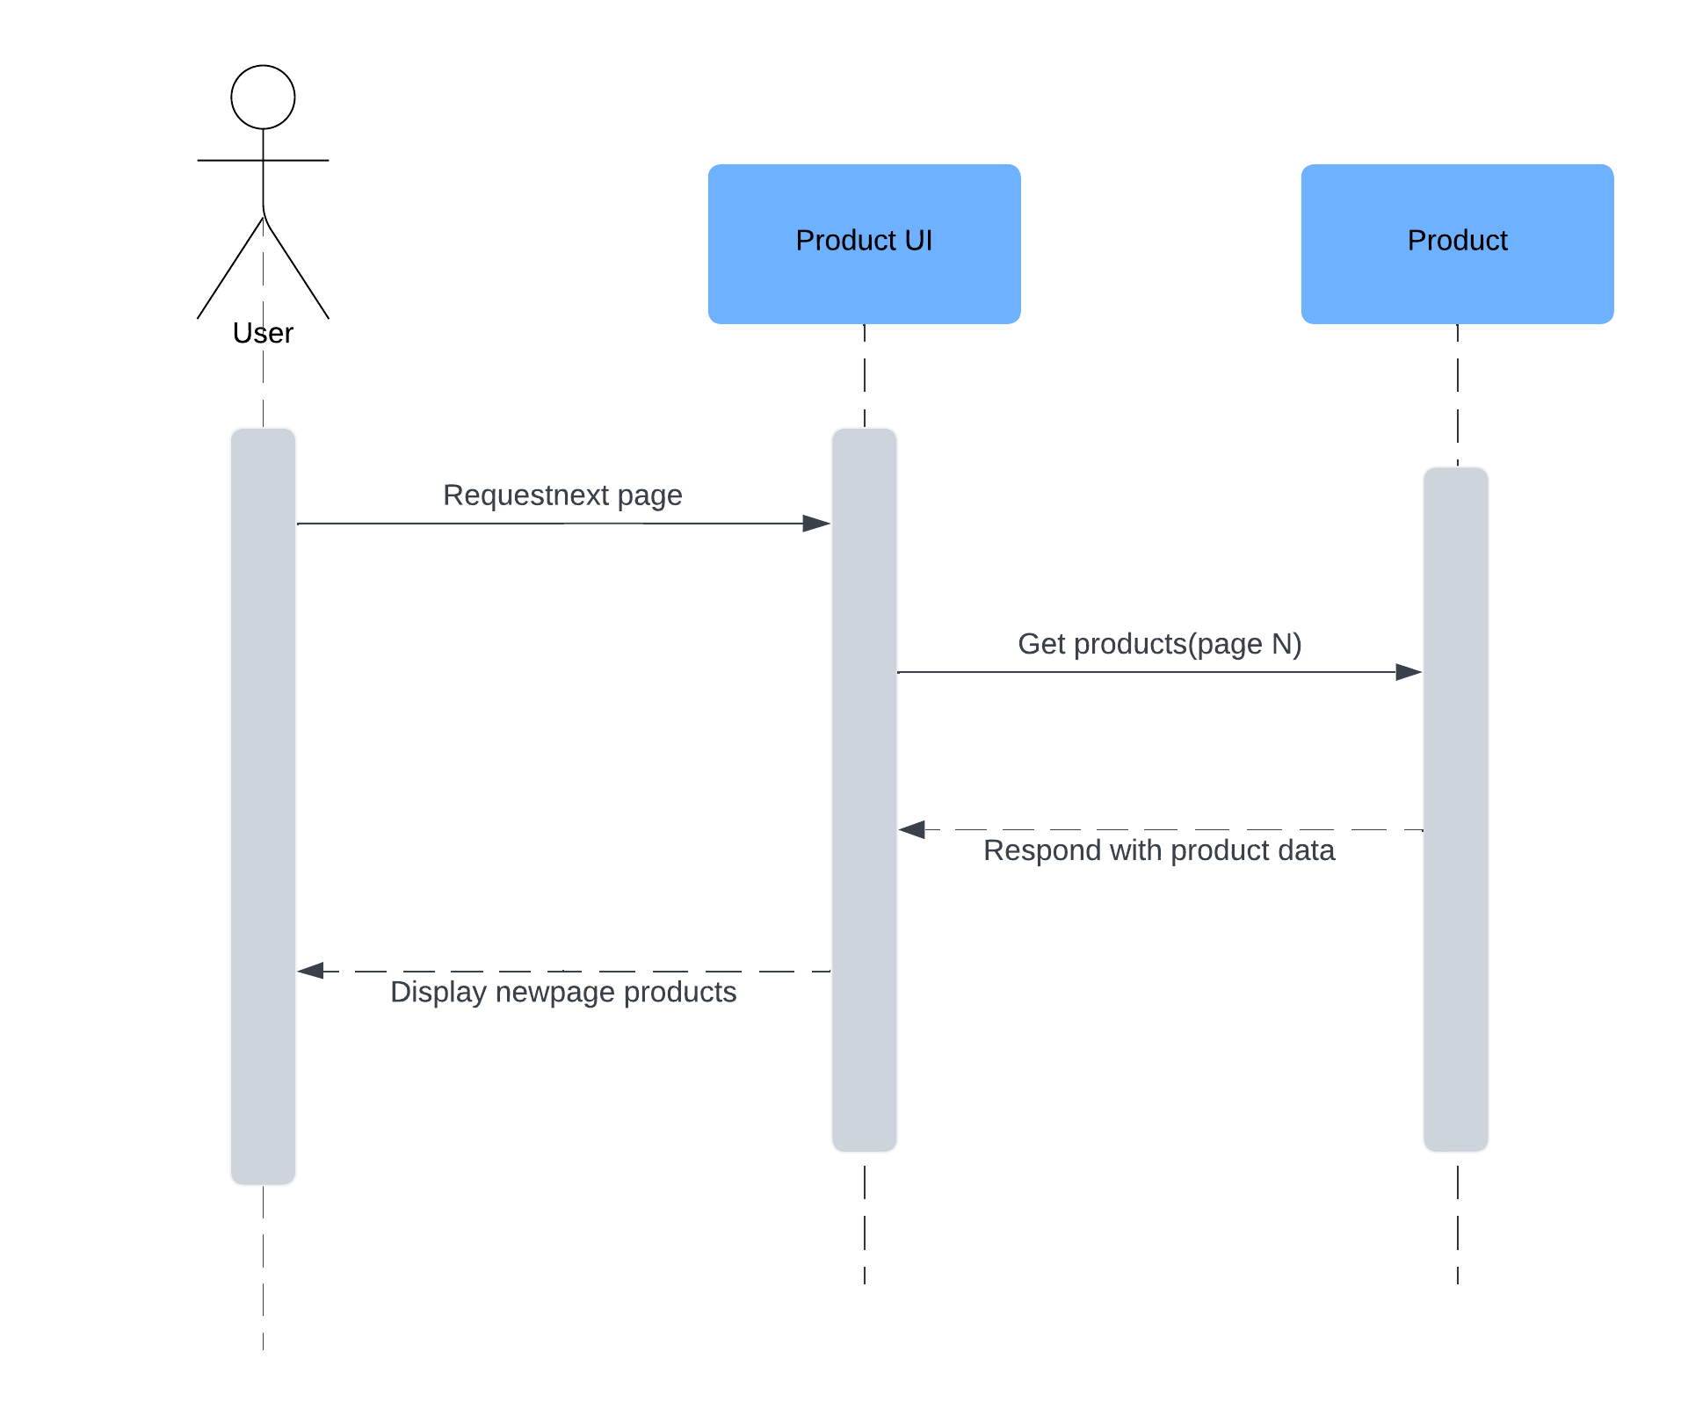
User Story – 02.06 Navigate Product Listings With Pagination
User Story Outline
1. This use case begins when the user requests to load the next page of product listings.
2. The system (Product Listings Page) receives the pagination request and forwards it to the Backend API.
3. Backend API retrieves the requested page data (Page N) from the database and returns the corresponding product information.
4. Product Listings Page displays the newly retrieved products to the user.
5. The use case ends when the user views the additional product listings.

